Slide 1

CS401 Modern Programming Practices (MPP) Professor Paul Corazza
MAHARISHI UNIVERSITY of MANAGEMENT
Engaging the Managing Intelligence of Nature
Computer Science Department

Slide 2
© 2015 Maharishi University of Management, Fairfield, Iowa
All rights reserved. No part of this slide presentation may be reproduced or utilized in any form or by any means, electronic or mechanical, including photocopying or recording, or by any information storage and retrieval system, without permission in writing from Maharishi University of Management.

Slide 3
Lecture 2: Associations, Modeling Relationships with UML
Diversifying Self-Referral Relationship
to the World of Objects

Slide 4
Wholeness Statement
In the real world, objects have relationships. These manifested relationships appear in many different ways. When these relationships are modeled in UML, those that reflect a permanent relationship are called associations.
At the most fundamental level every object is made out of the same essence – and is therefore (in a way) related to everything. An intellectual analysis or model of all these relationships is generally not practical.
A direct experience of the underlying reality of all of manifest creation and our relationship with all of nature is a result of our practice of Transcendental Meditation.

Slide 5
Overview
Types of relationships between classes: association, dependency, inheritance
Techniques for discovering associations
Identify verb phrases
Create an association matrix
Types of association
Unidirectional and bidirectional
Aggregation
Composition
Reflexive
Association classes
Association “decorations”: name, roles, multiplicities

Slide 6
Relationships Between Classes
In the OO paradigm, there are three fundamental types of relationships that can exist between classes
Association
Dependency
Inheritance (discussed in Lesson 3)

Slide 7
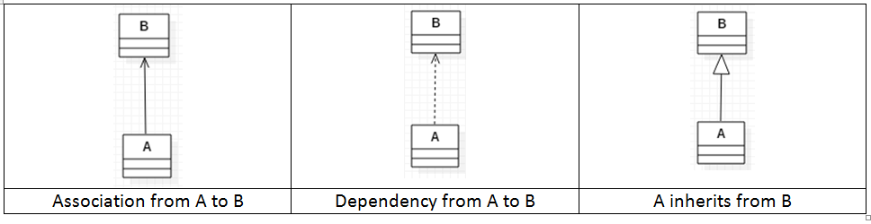
(continued)
Associations
“Customer has an Account”
Permanent relationship
Association from A to B implies A keeps a reference to B
Association from A to B implies it is possible to navigate from A to B at runtime
Dependencies
“Triangle uses Math” (see example)
Temporary relationship
Dependency from A to B implies A does not keep a reference to B

Slide 8
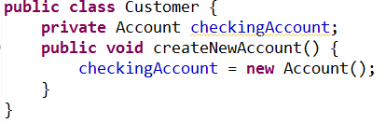
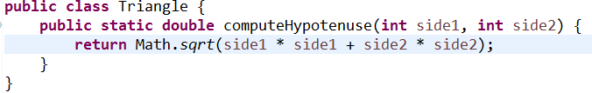
Two Examples
Association
Dependency

Slide 9


One-way and Two-way Associations
Sometimes should be able to navigate from A to B but not from B to A. This is a one-way association.
Sometimes should be able to navigate from A to B and also from B to A.

Slide 10
Overview
Types of relationships between classes: association, dependency, inheritance
Techniques for discovering associations
Identify verb phrases
Create an association matrix
Types of association
Unidirectional and bidirectional
Aggregation
Composition
Reflexive
Association classes
Association “decorations”: name, roles, multiplicities

Slide 11
Associations Specified by Verbs
Examples:
Customer has an Account
Professor advises a Student
Student enrolls in a Section
Strategy:
Discover associations by finding verbs and verb phrases in the problem statement.
Track the relationships in an Association Matrix

Slide 12
The Student Registration System
We have been asked to develop an automated Student Registration System (SRS) for the university. This system will enable students to register online for courses each semester, as well as track their progress toward completion of their degree.
When a student first enrolls at the university, he/she uses the SRS to create a plan of study that lists the courses he/she plans on taking to satisfy a particular degree program, and chooses a faculty advisor. The SRS will verify whether or not the proposed plan of study satisfies the requirements of the degree that the student is seeking.
Once a plan of study has been established, then, during the registration period preceding each semester, students are able to view the schedule of classes online, and choose whichever classes they wish to attend, indicating the preferred section (day of the week and time of day) if the class is offered by more than one professor. The SRS will verify whether or not the student has satisfied the necessary prerequisites for each requested course by referring to the student’s online transcript of courses completed and grades received (the student may review his/her transcript online at any time).
Assuming that (a) the prerequisites for the requested course(s) are satisfied, (b) the course(s) meet(s) one of the student’s plan of study requirements, and (c) there is room available in each of the class(es), the student is enrolled in the class(es).
If (a) and (b) are satisfied, but (c) is not, the student is placed on a first-come, first-served wait list. If a class/section that he/she was previously waitlisted for becomes available (either because some other student has dropped the class or because the seating capacity for the class has been increased), the student is automatically enrolled in the waitlisted class, and an email message to that effect is sent to the student. It is the student’s responsibility to drop the class if it is no longer desired; otherwise, he/she will be billed for the course.
Students may drop a class up to the end of the first week of the semester in which the class is being taught.

Slide 13
Association Matrix
 | Section | Course | Plan of Study | Professor | Student | Transcript
Section |  | instance of |  | Is taught by
Course
Plan of Study
Professor
Student
Transcript

Slide 14
Associations– In class Exercise
In your small groups refer to our problem description and fill in the Association Matrix for the classes we have identified for the SRS system.

Slide 15
 | Section | Course | Plan of Study | Professor | Student | Transcript
Section |  | instance of |  | is taught by |  | included in
Course |  | prerequisite for | is called for by
Plan of Study |  | calls for |  |  | observed by
Professor | teaches |  |  |  | advises; teaches
Student | registered for; waitlisted for; has previously taken | plans to take | observes | is advised by; studies under |  | owns
Transcript | Includes? | Includes? |  |  | belongs to

Slide 16
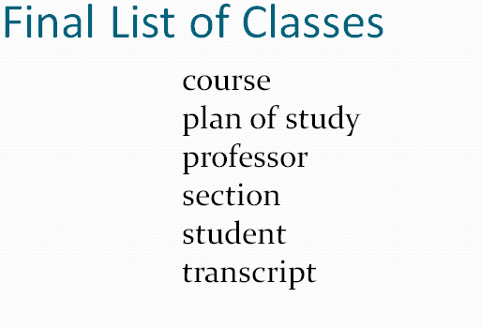
Problem Description – In class Exercise
In your small group now try to create a diagram with all the classes and their labeled associations (handout)

Slide 17
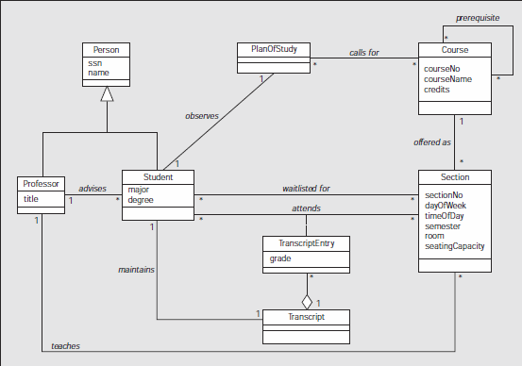
Student Registration System

Slide 18
Main Point 1
Building a software system using OO principles involves an analysis step in which the problem is analyzed and broken into pieces as objects are discovered. The pieces are then refined and put together -- in a step of synthesis – to give a picture of a unified system. This step of synthesis happens through the identification of relationships between classes, represented by associations. This phenomenon is a characteristic of all knowledge – it arises through a combination of analysis and synthesis.

Slide 19
Overview
Types of relationships between classes: association, dependency, inheritance
Techniques for discovering associations
Identify verb phrases
Create an association matrix
Types of association
Unidirectional and bidirectional
Aggregation
Composition
Reflexive
Association classes
Association “decorations”: name, roles, multiplicities

Slide 20
Describing Relationships
Relationships define how objects interact:
Student takes Sections
Professor teaches Sections
Client pays Vendor
Customer places Order
Relationships are often two-way streets:
Student takes Section
Section is taken by Student

Slide 21
Association
Unidirectional
Objects of a class have a reference to an object of another class.
First class keeps a reference to the second
Name that describes the association, often with a direction
Customer
places
Order
1
public class Customer {
private Order order;
}
public class Order {
}

Slide 22
Association
Bi-directional
Description direction is more important (still optional)
Customer
places
Order
1
1
public class Customer {
private Order order;
}
public class Order {
private Customer customer;
}

Slide 23
Association
A customer should be able to have more than one order outstanding …..
Customer
places
Order
1
1
public class Customer {
private Order order;
}
public class Order {
private Customer customer;
}

Slide 24
Association
1 one (mandatory)
three (exactly)
* many
0..* zero or more (optional)
1..* one or more
0..1 zero or one (optional)
Multiplicity
Customer
places
Order
1
0..*
public class Customer {
//private Order order;
}
public class Order {
private Customer customer;
}

Slide 25
Association
1 one (mandatory)
three (exactly)
* many
0..* zero or more (optional)
1..* one or more
0..1 zero or one (optional)
Multiplicity
Customer
places
Order
1
0..*
public class Customer {
private List<Order> orders;
}
public class Order {
private Customer customer;
}

Slide 26
Multiplicity
How many instances of each object must/may be associated with the other?
Optionality
Is the association required?
Cardinality
How many instances are associated with a given instance?
UML combines both ideas in the Multiplicity concept.

Slide 27
Association roles
A role is a (noun) description place on either side of the association to indicate the role(s) each object plays in the relationship.
Student
Faculty
advises
+advisees
+ advisor
public class Student {
private Faculty advisor;
}
public class Faculty {
private List<Student> advisees;
}

Slide 28
Main Point 2
Associations model the relationships that can exist between concepts. Simple (one-way) associations are modeled using an arrow; two-way associations are modeled using a line segment.
The association can have a name for ease of reading, and additional symbols to indicate direction and multiplicity.
The ends of an association arrow can also specify association roles.
The “simplest” association is the relationship of pure consciousness to itself; this can also be modeled with an arrow from pure consciousness to itself.

Slide 29
In-class Exercise
For the following problem statement work independently for 10 minutes to create the class diagram. Try to show the associations you need.
Then review your diagrams for 10 minutes with your small group.

Slide 30
Association Exercise
A Human Resource (HR) department keeps track of employees for several companies. Each company has a name and may consist of many departments. A department has a name and a location. Each department has one or more job positions. A position may be vacant. Otherwise, an employee is assigned to it. The HR personnel enter an employee’s first name, middle initial, last name, birth date and Social Security Number (SSN). An employee also has a unique employee id and a salary. A position has a title and a short description.

Slide 31
Aggregation
Represents a ‘whole-part’ relationship
‘contain’
‘is part of’
Code looks the same as an association.
Association name is implied
public class Department {
private List<Student> students;
}
public class Student {
private Department department;
}

Slide 32
Composition
Strong aggregation
‘whole-part’ relationship – “is composed of”
If whole dies, parts also die.
Company
Department
1
0..*

Slide 33
Composition
Code impacts? Will likely be in the logic for how we construct a department and what happens when a company is deleted.
Company
Department
1
0..*

Slide 34
Reflexive Association
Relationship between two or more objects of the same class.
Association role
+prerequisites
0..*
Course
What will the code be?

Slide 35
Reflexive Association
Relationship between two or more objects of the same class.
Association role
+prerequisites
0..*
Course
public class Course {
private List<Course> prerequisites;
}

Slide 36
Association Classes
Association Classes are useful to contain attributes of the link between objects.
These are often modeled this way during analysis
Student
attends
Section
*
*
GradeReceived
grade: String

Slide 37
Association Class - reworked
Student
attends
Section
*
*
GradeReceived
grade: String
During design, association classes are often re-worked to reflect the code instead of the concepts
Student
Section
gets
GradeReceived
issues
1
*
grade: String
*
1
attends

Slide 38
Main Point 3
There are several special forms of association, such as reflexive associations, aggregation, composition, and association classes.
Although most of these have their own symbols, you could still model these relationships without them.
The use of the symbols is to (easily) communicate additional information about the relationship.
Even these additional symbols are still based on the simple concept of an arrow. This is an example of diversity on the basis of unity.

Slide 39
Mid-Term Prep Exercise (3-2)
Objective: understand reflexive associations
Task: Draw a UML class diagram for each of the following problem statements.
1. Doubly-Linked List:
A LinkedList consists of zero or more ListItems. However, the LinkedList
class only knows about the first ListItem. Each ListItem knows its previous
and its next ListItem, if any.
2. Position Hierarchy:
A position may or may not be a managerial position. If it is a managerial
position, then other positions report to this one.
3. Course Prerequisites:
A university course may or may not require the student to have taken other courses first before taking this one. Any course can be a prerequisite course for any other course, except for itself.

Slide 40
Summary
Today we looked at modeling associations:
We can use an association matrix to analyze what the relations are between concepts
Associations are modeled with a line, a name describing the association, numbers on each side to indicate multiplicity, and optionally an arrow for directionality
Reflexive associations, aggregation, composition, and association classes are further model refinements of associations.

Slide 41
Connecting the Parts of Knowledge With the Wholeness of Knowledge
Class diagrams are defined in terms of classes and their relationships (associations)
Although there are various special association forms (composition, aggregation, etc.), all are variations of the fundamental concept of an association from one object to another.
Transcendental consciouness is related to itself through its own self-referral dynamics.
Wholeness moving within itself: In Unity Consciousness, one recognizes that the relationship of the Self to the Self is not only fundamental, but is in reality the only relationship there is.

